Slide 1
Benchmarking NoSQL databases
TEAM : SVN
Sarat Chandra Vysyaraju
VENCIYA Antony George
NitEsh CHAUHAN

Slide 2



Databases & Workloads
Cassandra 3.5
HBase 2.7.1
MongoDB 3.2.6
1. 50% Reads & 50% Updates.
2. 95% Read (heavy read) & 5% Updates.
3. 100% Reads (Read Intensive).
4. 95% Read (heavy read) & 5% Insert.
5. 95% Updates (heavy write) & 5% Reads.

Slide 3
Project Outline
YCSB set-up
Database Installation
Testing Drivers
Data Load Phase
Building Workloads
Testing workloads and analysis

Slide 4
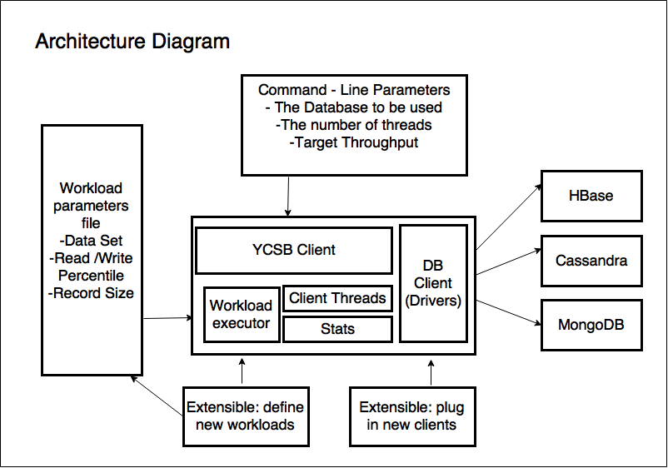
YCSB Architecture

Slide 5
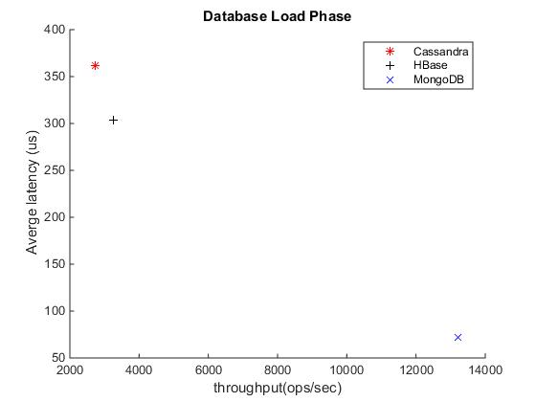
Load Phase
We inserted 1 million data points of size 1KB each for each of the databases which was equivalent nearly 1GB

Slide 6
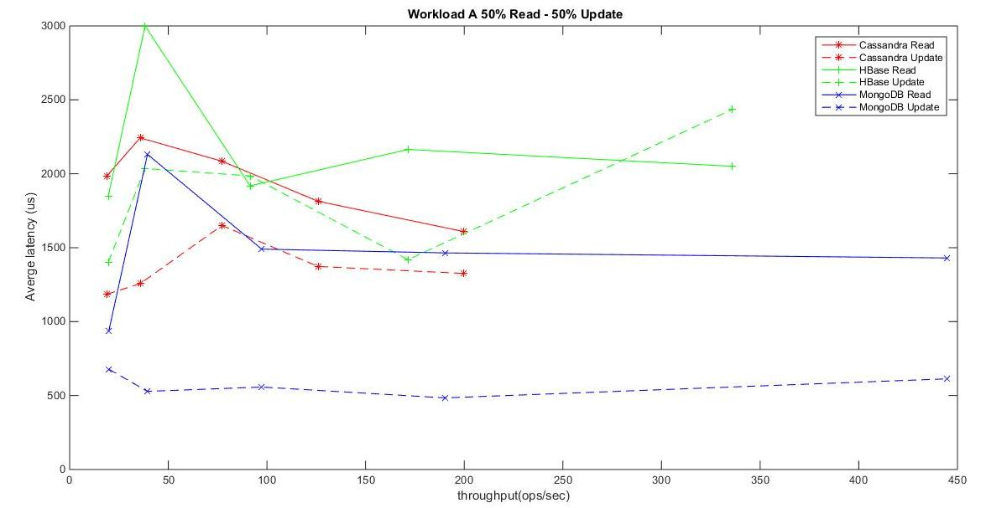
50% Reads & 50% Updates

Slide 7
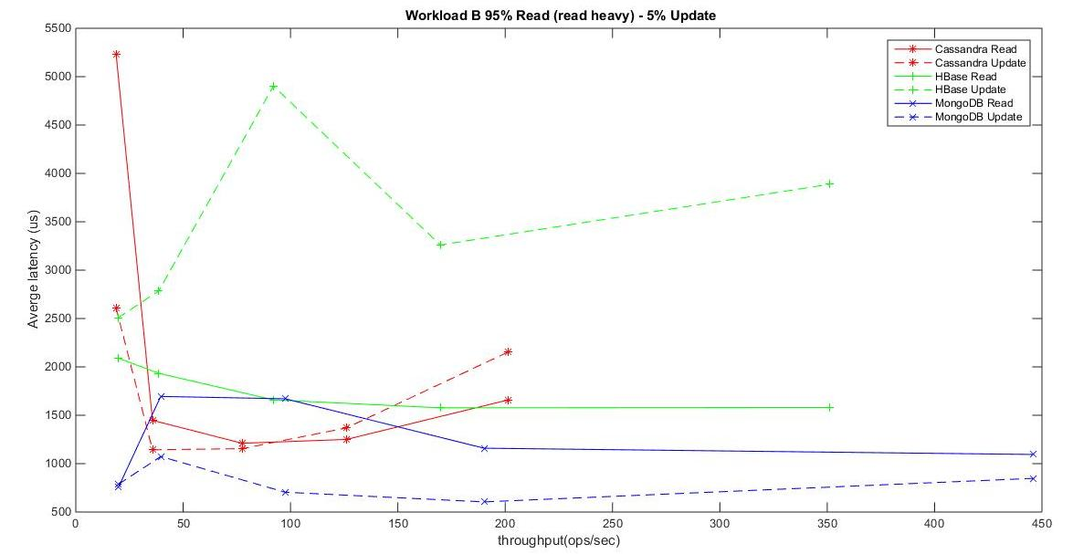
95% Read (heavy read) & 5% Updates.

Slide 8
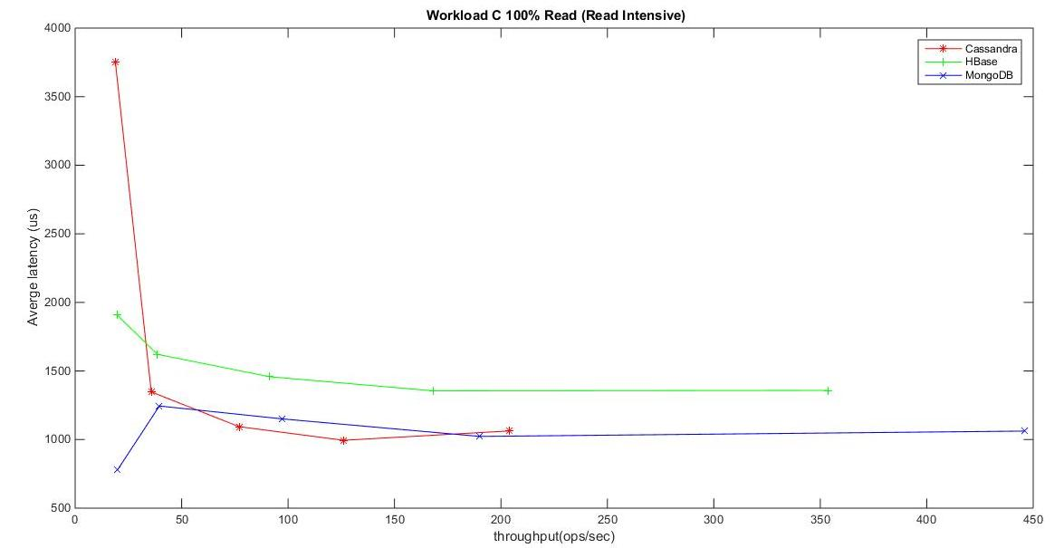
100% Reads (Read Intensive)

Slide 9
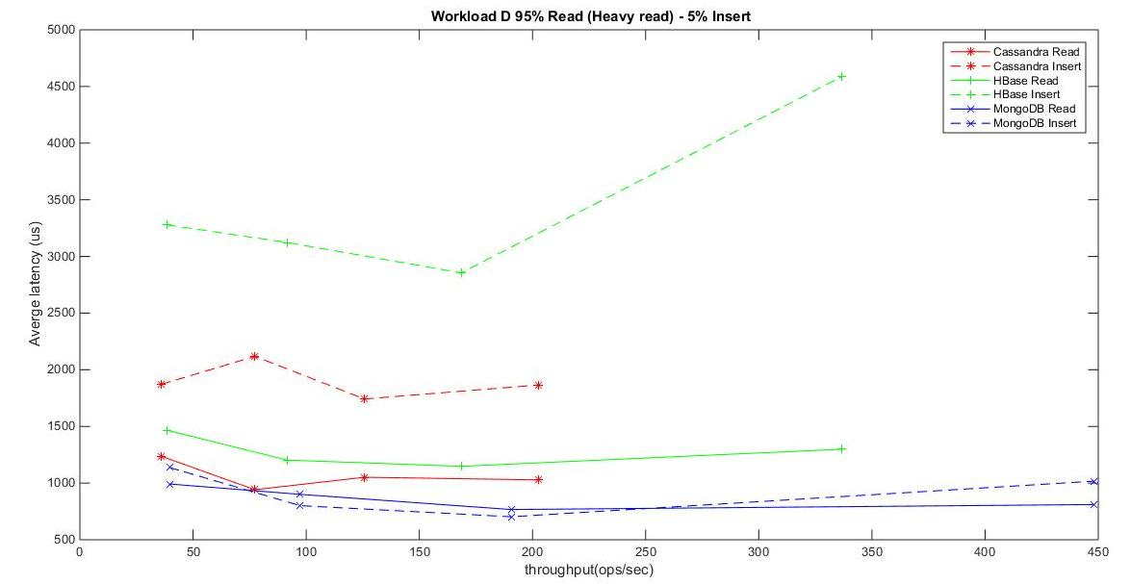
95% Read (heavy read) & 5% Insert

Slide 10
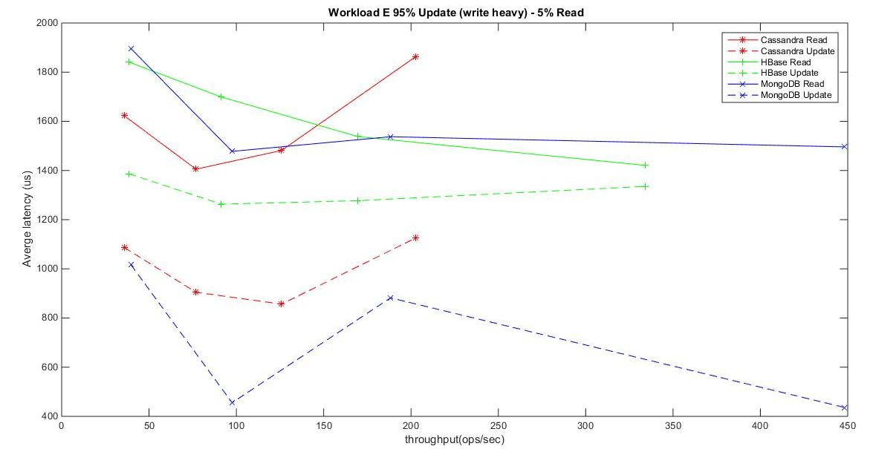
95% Updates (heavy write) & 5% Reads

